Slide 1

6+++++
Health Risk Behaviors Among
Missouri High School Students
Shaquille Christmas, MPH, Lisa Giles, MPH, Anthony Belenchia, PhD
The 2021 Missouri Youth Risk Behavior Survey was conducted by the Missouri Department of Health and Senior Services with funding provided by a cooperative agreement between the U.S. Centers for Disease Control and Prevention and the Missouri Department of Elementary and Secondary Education

Slide 2
Agenda
Background
Data Review
Summary
Q&A

Slide 3
What is the YRBS?
Student demographics:
Health behaviors
Substance use:
Student experiences:
Sex
Sexual identity
Race and ethnicity
Grade
Sexual
Injury and violence
Bullying
Diet and physical activity
Obesity
Mental health (including suicide)
Electronic vapor product
Tobacco product use
Alcohol, and other drug use
Parental monitoring
School connectivity
Unstable housing
Exposure to community violence
Notes:
Administered every other year
A set of surveys that track behaviors that can lead to poor health in students grades 9 through 12.
From 1991 through 2021, the YRBSS has collected data from more than 5 million high school students in more than 2,200 separate surveys

Slide 4
Why is the YRBS Conducted?
Monitor adolescent health behavior changes over time
Inform school, community programs, and communications campaigns
Monitor progress toward achieving the Healthy People Objectives
Notes:
YRBS results help monitor adolescent health behavior changes over time, identify emerging issues, and plan and evaluate programs to support the health of youth.
YRBS data are used by health departments, educators, lawmakers, doctors, and community organizations to inform school and community programs, communications campaigns, and other efforts.
Determine how often unhealthy behaviors occur
Assess whether unhealthy behaviors increase, decrease, or stay the same over time
Provide data at the national, state, territorial and freely associated state, tribal, and local levels
Provide data comparing different groups of adolescents
Monitor progress toward achieving the Healthy People Objectives and other program goals

Slide 5





How is the YRBS conducted?
Survey Administered
Classroom Selection
CDC Analysis
School/Class Selection
Data Dissemination
Notes:
https://health.mo.gov/data/yrbss/
Limitations
1) School-based survey so it does not take into account home-schooled students or teens of school age that are not enrolled in school at all
2) YRBS focuses on behavior and not determinants of those behaviors. Intervention programs must consider determinants during development
Centers for Disease Control and Prevention. Methodology of the Youth Risk Behavior Surveillance System — 2013. MMWR 2013;62(No. RR-1):[01-25]. (https://www.cdc.gov/mmwr/pdf/rr/rr6201.pdf)

Slide 6
YRBS Quick FAQs
Students do not put their name nor any other identifying information (such as a school ID number) on the survey.
Research indicates student’s responses are reliable
Possibly. In previous years CDC and DESE have agreed to provide financial grants.
There is no evidence that asking these questions will lead to an increase in the likelihood that youth will practice risky behaviors.
Are student’s names used or linked to the survey?
Do students answer questions truthfully?
Incentives for schools completing the survey?
Do survey questions increase the chance of risky behaviors?

Slide 7

Asthma

Slide 8
Percentage of High School Students Who Currently Have Asthma, by Sex, Grade and Race/Ethnicity,* 2021
*B > H, B > W (Based on t-test analysis, p < 0.05.)
All Hispanic students are included in the Hispanic category. All other races are non-Hispanic.
This graph contains weighted results.
Missouri - YRBS, 2021 - QN108
Notes:
Data for this slide are from the 2021 Missouri Youth Risk Behavior Survey. This slide shows percentages of high school students who currently have asthma.
The percentage for all students is 17.1. The percentage for Male students is 18.6. The percentage for Female students is 15.5. The percentage for 9th grade students is 15.1. The percentage for 10th grade students is 17.3. The percentage for 11th grade students is 17.2. The percentage for 12th grade students is 19.5. The percentage for Black students is 33.6. The percentage for Hispanic/Latino students is 13.4. The percentage for White students is 14.2. All Hispanic students are included in the Hispanic category. All other races are non-Hispanic. This graph contains weighted results.
For this behavior, the prevalence for Black students is higher than for Hispanic students. The prevalence for Black students is higher than for White students. (Based on t-test analysis, p < 0.05.)

Slide 9
Bullying

Slide 10
Percentage of High School Students Who Were Bullied on School Property,* by Sex,† Grade and Race/Ethnicity, 2021
*Ever during the 12 months before the survey
†F > M (Based on t-test analysis, p < 0.05.)
All Hispanic students are included in the Hispanic category. All other races are non-Hispanic.
This graph contains weighted results.
Missouri - YRBS, 2021 - QN23
Notes:
Data for this slide are from the 2021 Missouri Youth Risk Behavior Survey. This slide shows the percentage of high school students who were bullied on school property (ever during the 12 months before the survey).
The percentage for all students is 15.4. The percentage for Male students is 12.9. The percentage for Female students is 18.2. The percentage for 9th grade students is 18.0. The percentage for 10th grade students is 16.2. The percentage for 11th grade students is 14.2. The percentage for 12th grade students is 12.3. The percentage for Black students is 12.6. The percentage for Hispanic/Latino students is 18.6. The percentage for White students is 15.4. All Hispanic students are included in the Hispanic category. All other races are non-Hispanic. This graph contains weighted results.
For this behavior, the prevalence for female students is higher than for male students. (Based on t-test analysis, p < 0.05.)

Slide 11
Percentage of High School Students Who Were Bullied on School Property,* 2009-2021†
*Ever during the 12 months before the survey
†Decreased 2009-2021, no change 2009-2017, decreased 2017-2021 [Based on linear and quadratic trend analyses using logistic regression models controlling for sex, race/ethnicity, and grade (p < 0.05). Significant linear trends (if present) across all available years are described first followed by linear changes in each segment of significant quadratic trends (if present).]
Data not available for 2011.
This graph contains weighted results.
Missouri - YRBS, 2009-2021 - QN23
Notes:
These are results from the Missouri Youth Risk Behavior Surveys, 2009-2021. This slide shows percentages from 2009 through 2021 for high school students who were bullied on school property (ever during the 12 months before the survey).
The percentage for 2009 is 22.8. The percentage for 2013 is 25.2. The percentage for 2015 is 21.4. The percentage for 2017 is 23.3. The percentage for 2019 is 21.0. The percentage for 2021 is 15.4.
Significant linear trends (if present) across all available years are described first followed by linear changes in each segment of significant quadratic trends (if present). For this behavior, based on linear and quadratic trend analyses using logistic regression models controlling for sex, race/ethnicity, and grade (p < 0.05), the prevalence decreased from 2009 to 2021, did not change from 2009 to 2017, and decreased from 2017 to 2021.Data not available for 2011. This graph contains weighted results.

Slide 12
Percentage of High School Students Who Were Electronically Bullied,* by Sex,† Grade and Race/Ethnicity,† 2021
*Counting being bullied through texting, Instagram, Facebook, or other social media, ever during the 12 months before the survey
†F > M; W > B (Based on t-test analysis, p < 0.05.)
All Hispanic students are included in the Hispanic category. All other races are non-Hispanic.
This graph contains weighted results.
Missouri - YRBS, 2021 - QN24
Notes:
Data for this slide are from the 2021 Missouri Youth Risk Behavior Survey. This slide shows the percentage of high school students who were electronically bullied (counting being bullied through texting, Instagram, Facebook, or other social media, ever during the 12 months before the survey).
The percentage for all students is 13.9. The percentage for Male students is 9.1. The percentage for Female students is 19.1. The percentage for 9th grade students is 14.5. The percentage for 10th grade students is 13.5. The percentage for 11th grade students is 16.8. The percentage for 12th grade students is 10.3. The percentage for Black students is 9.1. The percentage for Hispanic/Latino students is 17.0. The percentage for White students is 15.1. All Hispanic students are included in the Hispanic category. All other races are non-Hispanic. This graph contains weighted results.
For this behavior, the prevalence for female students is higher than for male students. The prevalence for White students is higher than for Black students. (Based on t-test analysis, p < 0.05.)

Slide 13
Percentage of High School Students Who Were Electronically Bullied,* 2015-2021†
*Counting being bullied through texting, Instagram, Facebook, or other social media, ever during the 12 months before the survey
†No change 2015-2021 [Based on linear trend analyses using logistic regression models controlling for sex, race/ethnicity, and grade (p < 0.05).]
This graph contains weighted results.
Missouri - YRBS, 2015-2021 - QN24
Notes:
These are results from the Missouri Youth Risk Behavior Surveys, 2015-2021. This slide shows percentages from 2015 through 2021 for high school students who were electronically bullied (counting being bullied through texting, Instagram, Facebook, or other social media, ever during the 12 months before the survey).
The percentage for 2015 is 16.6. The percentage for 2017 is 19.4. The percentage for 2019 is 18.1. The percentage for 2021 is 13.9.
For this behavior, based on linear trend analyses using logistic regression models controlling for sex, race/ethnicity, and grade (p < 0.05), the prevalence did not change from 2015 to 2021. This graph contains weighted results.

Slide 14
Children Out of
The Home

Slide 15
Percentage of High School Students Who Usually Did Not Sleep in Their Parent's or Guardian's Home,* by Sex, Grade† and Race/Ethnicity, 2021
*During the 30 days before the survey
†10th > 9th (Based on t-test analysis, p < 0.05.)
All Hispanic students are included in the Hispanic category. All other races are non-Hispanic.
This graph contains weighted results.
Missouri - YRBS, 2021 - QN87
Notes:
Data for this slide are from the 2021 Missouri Youth Risk Behavior Survey. This slide shows the percentage of high school students who usually did not sleep in their parent's or guardian's home (during the 30 days before the survey
).
The percentage for all students is 3.3. The percentage for Male students is 4.3. The percentage for Female students is 2.2. The percentage for 9th grade students is 3.0. The percentage for 10th grade students is 5.6. The percentage for 11th grade students is 2.3. The percentage for 12th grade students is 2.3. The percentage for Black students is 4.0. The percentage for Hispanic/Latino students is 1.7. The percentage for White students is 3.0. All Hispanic students are included in the Hispanic category. All other races are non-Hispanic. This graph contains weighted results.
For this behavior, the prevalence for 10th grade students is higher than for 9th grade students. (Based on t-test analysis, p < 0.05.)

Slide 16
Percentage of High School Students Who Have Ever Slept Away from Their Parents or Guardians Because They Were Kicked Out, Ran Away, or Were Abandoned,* by Sex, Grade† and Race/Ethnicity, 2021
*During the 30 days before the survey
†9th > 10th, 12th > 10th (Based on t-test analysis, p < 0.05.)
All Hispanic students are included in the Hispanic category. All other races are non-Hispanic.
This graph contains weighted results.
Missouri - YRBS, 2021 - QN109
Notes:
Data for this slide are from the 2021 Missouri Youth Risk Behavior Survey. This slide shows the percentage of high school students who have ever slept away from their parents or guardians because they were kicked out, ran away, or were abandoned (during the 30 days before the survey).
The percentage for all students is 6.4. The percentage for Male students is 6.9. The percentage for Female students is 5.9. The percentage for 9th grade students is 8.2. The percentage for 10th grade students is 3.9. The percentage for 11th grade students is 4.9. The percentage for 12th grade students is 8.1. The percentage for Black students is 10.7. The percentage for Hispanic/Latino students is 7.4. The percentage for White students is 5.4. All Hispanic students are included in the Hispanic category. All other races are non-Hispanic. This graph contains weighted results.
For this behavior, the prevalence for 9th grade students is higher than for 10th grade students. The prevalence for 12th grade students is higher than for 10th grade students. (Based on t-test analysis, p < 0.05.)

Slide 17
Alcohol, Tobacco, E-Cigarette
and Illicit Drug Use

Slide 18
Percentage of High School Students Who Currently Drank Alcohol,* by Sex, Grade† and Race/Ethnicity,† 2021
*At least one drink of alcohol, on at least 1 day during the 30 days before the survey
†11th > 9th, 12th > 9th, 12th > 10th, 12th > 11th; W > B (Based on t-test analysis, p < 0.05.)
All Hispanic students are included in the Hispanic category. All other races are non-Hispanic.
This graph contains weighted results.
Missouri - YRBS, 2021 - QN41
Notes:
Data for this slide are from the 2021 Missouri Youth Risk Behavior Survey. This slide shows the percentage of high school students who currently drank alcohol (at least one drink of alcohol, on at least 1 day during the 30 days before the survey).
The percentage for all students is 24.3. The percentage for Male students is 21.7. The percentage for Female students is 27.5. The percentage for 9th grade students is 15.3. The percentage for 10th grade students is 20.3. The percentage for 11th grade students is 26.3. The percentage for 12th grade students is 36.8. The percentage for Black students is 14.3. The percentage for Hispanic/Latino students is 25.3. The percentage for White students is 25.9. All Hispanic students are included in the Hispanic category. All other races are non-Hispanic. This graph contains weighted results.
For this behavior, the prevalence for 11th grade students is higher than for 9th grade students. The prevalence for 12th grade students is higher than for 9th grade students. The prevalence for 12th grade students is higher than for 10th grade students. The prevalence for 12th grade students is higher than for 11th grade students. The prevalence for White students is higher than for Black students. (Based on t-test analysis, p < 0.05.)

Slide 19
Percentage of High School Students Who Currently Drank Alcohol,* 1995-2021†
*At least one drink of alcohol, on at least 1 day during the 30 days before the survey
†Decreased 1995-2021 [Based on linear and quadratic trend analyses using logistic regression models controlling for sex, race/ethnicity, and grade (p < 0.05). Significant linear trends (if present) across all available years are described first followed by linear changes in each segment of significant quadratic trends (if present).]
Data not available for 2011.
This graph contains weighted results.
Missouri - YRBS, 1995-2021 - QN41
Notes:
These are results from the Missouri Youth Risk Behavior Surveys, 1995-2021. This slide shows percentages from 1995 through 2021 for high school students who currently drank alcohol (at least one drink of alcohol, on at least 1 day during the 30 days before the survey).
The percentage for 1995 is 55.7. The percentage for 1997 is 51.4. The percentage for 1999 is 49.9. The percentage for 2001 is 47.6. The percentage for 2003 is 49.2. The percentage for 2005 is 40.8. The percentage for 2007 is 44.4. The percentage for 2009 is 39.3. The percentage for 2013 is 35.6. The percentage for 2015 is 34.5. The percentage for 2017 is 32.0. The percentage for 2019 is 27.9. The percentage for 2021 is 24.3.
Significant linear trends (if present) across all available years are described first followed by linear changes in each segment of significant quadratic trends (if present). For this behavior, based on linear and quadratic trend analyses using logistic regression models controlling for sex, race/ethnicity, and grade (p < 0.05), the prevalence decreased from 1995 to 2021. Data not available for 2011. This graph contains weighted results.

Slide 20
Percentage of High School Students Who Currently Were Binge Drinking,* by Sex, Grade† and Race/Ethnicity,† 2021
*Had four or more drinks of alcohol in a row if they were female or five or more drinks of alcohol in a row if they were male, within a couple of hours, on at least 1 day during the 30 days before the survey
†11th > 9th, 12th > 9th, 12th > 10th; W > B (Based on t-test analysis, p < 0.05.)
All Hispanic students are included in the Hispanic category. All other races are non-Hispanic.
This graph contains weighted results.
Missouri - YRBS, 2021 - QN42
Notes:
Data for this slide are from the 2021 Missouri Youth Risk Behavior Survey. This slide shows the percentage of high school students who currently were binge drinking (had four or more drinks of alcohol in a row if they were female or five or more drinks of alcohol in a row if they were male, within a couple of hours, on at least 1 day during the 30 days before the survey).
The percentage for all students is 14.1. The percentage for Male students is 12.7. The percentage for Female students is 15.7. The percentage for 9th grade students is 8.3. The percentage for 10th grade students is 11.0. The percentage for 11th grade students is 16.2. The percentage for 12th grade students is 21.8. The percentage for Black students is 5.0. The percentage for Hispanic/Latino students is 13.1. The percentage for White students is 16.4. All Hispanic students are included in the Hispanic category. All other races are non-Hispanic. This graph contains weighted results.
For this behavior, the prevalence for 11th grade students is higher than for 9th grade students. The prevalence for 12th grade students is higher than for 9th grade students. The prevalence for 12th grade students is higher than for 10th grade students. The prevalence for White students is higher than for Black students. (Based on t-test analysis, p < 0.05.)

Slide 22
Percentage of High School Students Who Currently Used an Electronic Vapor Product,* by Sex, Grade† and Race/Ethnicity, 2021
*Including e-cigarettes, vapes, vape pens, e-cigars, e-hookahs, hookah pens, and mods [such as JUUL, SMOK, Suorin, Vuse, and blu], on at least 1 day during the 30 days before the survey
†11th > 9th, 12th > 9th (Based on t-test analysis, p < 0.05.)
All Hispanic students are included in the Hispanic category. All other races are non-Hispanic.
This graph contains weighted results.
Missouri - YRBS, 2021 - QN35
Notes:
Data for this slide are from the 2021 Missouri Youth Risk Behavior Survey. This slide shows the percentage of high school students who currently used an electronic vapor product (including e-cigarettes, vapes, vape pens, e-cigars, e-hookahs, hookah pens, and mods [such as JUUL, SMOK, Suorin, Vuse, and blu], on at least 1 day during the 30 days before the survey).
The percentage for all students is 19.3. The percentage for Male students is 17.6. The percentage for Female students is 21.3. The percentage for 9th grade students is 11.1. The percentage for 10th grade students is 17.8. The percentage for 11th grade students is 25.3. The percentage for 12th grade students is 24.6. The percentage for Black students is 12.8. The percentage for Hispanic/Latino students is 15.4. The percentage for White students is 21.5. All Hispanic students are included in the Hispanic category. All other races are non-Hispanic. This graph contains weighted results.
For this behavior, the prevalence for 11th grade students is higher than for 9th grade students. The prevalence for 12th grade students is higher than for 9th grade students. (Based on t-test analysis, p < 0.05.)

Slide 23
Percentage of High School Students Who Currently Used Marijuana,* by Sex, Grade† and Race/Ethnicity,† 2021
*One or more times during the 30 days before the survey
†11th > 10th; B > H, B > W (Based on t-test analysis, p < 0.05.)
All Hispanic students are included in the Hispanic category. All other races are non-Hispanic.
This graph contains weighted results.
Missouri - YRBS, 2021 - QN47
Notes:
Data for this slide are from the 2021 Missouri Youth Risk Behavior Survey. This slide shows the percentage of high school students who currently used marijuana (one or more times during the 30 days before the survey).
The percentage for all students is 16.7. The percentage for Male students is 15.4. The percentage for Female students is 18.0. The percentage for 9th grade students is 14.0. The percentage for 10th grade students is 14.1. The percentage for 11th grade students is 22.2. The percentage for 12th grade students is 17.5. The percentage for Black students is 23.6. The percentage for Hispanic/Latino students is 12.6. The percentage for White students is 16.4. All Hispanic students are included in the Hispanic category. All other races are non-Hispanic. This graph contains weighted results.
For this behavior, the prevalence for 11th grade students is higher than for 10th grade students. The prevalence for Black students is higher than for Hispanic students. The prevalence for Black students is higher than for White students. (Based on t-test analysis, p < 0.05.)

Slide 24
Percentage of High School Students Who Ever Took Prescription Pain Medicine Without a Doctor's Prescription or Differently Than How a Doctor Told Them to Use It,* by Sex,† Grade and Race/Ethnicity, 2021
*Counting drugs such as codeine, Vicodin, OxyContin, Hydrocodone, and Percocet, one or more times during their life
†F > M (Based on t-test analysis, p < 0.05.)
All Hispanic students are included in the Hispanic category. All other races are non-Hispanic.
This graph contains weighted results.
Missouri - YRBS, 2021 - QN49
Notes:
Data for this slide are from the 2021 Missouri Youth Risk Behavior Survey. This slide shows the percentage of high school students who ever took prescription pain medicine without a doctor's prescription or differently than how a doctor told them to use it (counting drugs such as codeine, Vicodin, OxyContin, Hydrocodone, and Percocet, one or more times during their life).
The percentage for all students is 16.8. The percentage for Male students is 13.3. The percentage for Female students is 20.2. The percentage for 9th grade students is 19.3. The percentage for 10th grade students is 15.8. The percentage for 11th grade students is 16.6. The percentage for 12th grade students is 15.0. The percentage for Black students is 23.4. The percentage for Hispanic/Latino students is 20.4. The percentage for White students is 15.3. All Hispanic students are included in the Hispanic category. All other races are non-Hispanic. This graph contains weighted results.
For this behavior, the prevalence for female students is higher than for male students. (Based on t-test analysis, p < 0.05.)

Slide 25
Percentage of High School Students Who Were Offered, Sold, or Given an Illegal Drug on School Property,* by Sex,† Grade and Race/Ethnicity, 2021
*During the 12 months before the survey
†M > F (Based on t-test analysis, p < 0.05.)
All Hispanic students are included in the Hispanic category. All other races are non-Hispanic.
This graph contains weighted results.
Missouri - YRBS, 2021 - QN56
Notes:
Data for this slide are from the 2021 Missouri Youth Risk Behavior Survey. This slide shows the percentage of high school students who were offered, sold, or given an illegal drug on school property (during the 12 months before the survey).
The percentage for all students is 12.8. The percentage for Male students is 15.4. The percentage for Female students is 10.4. The percentage for 9th grade students is 13.1. The percentage for 10th grade students is 13.0. The percentage for 11th grade students is 15.6. The percentage for 12th grade students is 9.2. The percentage for Black students is 9.5. The percentage for Hispanic/Latino students is 16.5. The percentage for White students is 13.9. All Hispanic students are included in the Hispanic category. All other races are non-Hispanic. This graph contains weighted results.
For this behavior, the prevalence for male students is higher than for female students. (Based on t-test analysis, p < 0.05.)

Slide 26
Mental Health

Slide 27
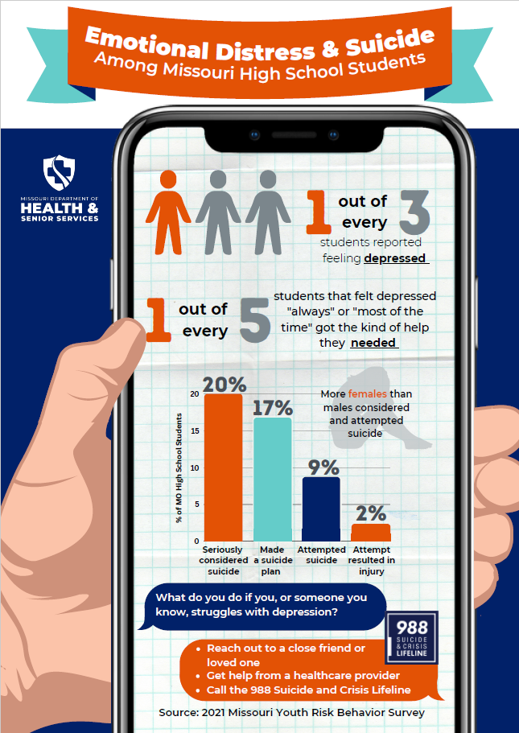

Slide 28
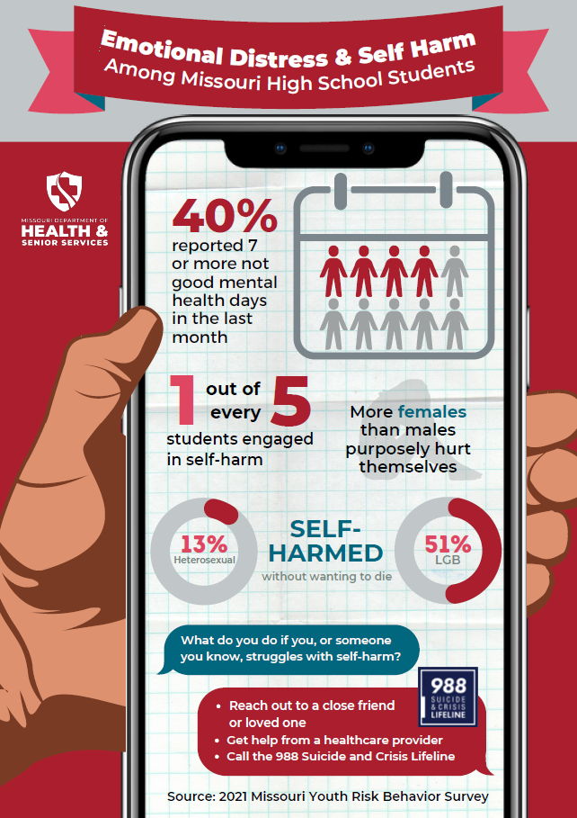

Slide 29
Nutrition and Physical Activity

Slide 30
Percentage of High School Students Who Ate Breakfast on All 7 Days,* by Sex,† Grade and Race/Ethnicity,† 2021
*During the 7 days before the survey
†M > F; W > B (Based on t-test analysis, p < 0.05.)
All Hispanic students are included in the Hispanic category. All other races are non-Hispanic.
This graph contains weighted results.
Missouri - YRBS, 2021 - QNBK7DAY
Notes:
Data for this slide are from the 2021 Missouri Youth Risk Behavior Survey. This slide shows the percentage of high school students who ate breakfast on all 7 days (during the 7 days before the survey).
The percentage for all students is 23.5. The percentage for Male students is 28.8. The percentage for Female students is 18.4. The percentage for 9th grade students is 24.8. The percentage for 10th grade students is 23.8. The percentage for 11th grade students is 24.6. The percentage for 12th grade students is 20.3. The percentage for Black students is 9.8. The percentage for Hispanic/Latino students is 28.1. The percentage for White students is 25.0. All Hispanic students are included in the Hispanic category. All other races are non-Hispanic. This graph contains weighted results.
For this behavior, the prevalence for male students is higher than for female students. The prevalence for White students is higher than for Black students. (Based on t-test analysis, p < 0.05.)

Slide 31
Percentage of High School Students Who Ate Breakfast on All 7 Days,* 2013-2021†
*During the 7 days before the survey
†Decreased 2013-2021 [Based on linear trend analyses using logistic regression models controlling for sex, race/ethnicity, and grade (p < 0.05).]
This graph contains weighted results.
Missouri - YRBS, 2013-2021 - QNBK7DAY
Notes:
These are results from the Missouri Youth Risk Behavior Surveys, 2013-2021. This slide shows percentages from 2013 through 2021 for high school students who ate breakfast on all 7 days (during the 7 days before the survey).
The percentage for 2013 is 35.6. The percentage for 2015 is 30.9. The percentage for 2017 is 32.2. The percentage for 2019 is 27.7. The percentage for 2021 is 23.5.
For this behavior, based on linear trend analyses using logistic regression models controlling for sex, race/ethnicity, and grade (p < 0.05), the prevalence decreased from 2013 to 2021. This graph contains weighted results.

Slide 32
Percentage of High School Students Who Had Obesity,* by Sex,† Grade† and Race/Ethnicity,† 2021
* ≥ 95th percentile for body mass index, based on sex- and age-specific reference data from the 2000 CDC growth charts. In 2017, new, slightly different ranges were used to calculate biologically implausible responses to height and weight questions.
†M > F; 10th > 11th; B > W (Based on t-test analysis, p < 0.05.)
All Hispanic students are included in the Hispanic category. All other races are non-Hispanic.
This graph contains weighted results.
Missouri - YRBS, 2021 - QNOBESE
Notes:
Data for this slide are from the 2021 Missouri Youth Risk Behavior Survey. This slide shows the percentage of high school students who had obesity ( ≥ 95th percentile for body mass index, based on sex- and age-specific reference data from the 2000 CDC growth charts. In 2017, new, slightly different ranges were used to calculate biologically implausible responses to height and weight questions.).
The percentage for all students is 16.9. The percentage for Male students is 22.4. The percentage for Female students is 10.9. The percentage for 9th grade students is 17.3. The percentage for 10th grade students is 19.0. The percentage for 11th grade students is 13.6. The percentage for 12th grade students is 17.2. The percentage for Black students is 24.2. The percentage for Hispanic/Latino students is 17.2. The percentage for White students is 14.8. All Hispanic students are included in the Hispanic category. All other races are non-Hispanic. This graph contains weighted results.
For this behavior, the prevalence for male students is higher than for female students. The prevalence for 10th grade students is higher than for 11th grade students. The prevalence for Black students is higher than for White students. (Based on t-test analysis, p < 0.05.)

Slide 33
Percentage of High School Students Who Had Obesity,* 1999-2021†
* ≥ 95th percentile for body mass index, based on sex- and age-specific reference data from the 2000 CDC growth charts. In 2017, new, slightly different ranges were used to calculate biologically implausible responses to height and weight questions.
†Increased 1999-2021 [Based on linear and quadratic trend analyses using logistic regression models controlling for sex, race/ethnicity, and grade (p < 0.05). Significant linear trends (if present) across all available years are described first followed by linear changes in each segment of significant quadratic trends (if present).]
Data not available for 2011.
This graph contains weighted results.
Missouri - YRBS, 1999-2021 - QNOBESE
Notes:
These are results from the Missouri Youth Risk Behavior Surveys, 1999-2021. This slide shows percentages from 1999 through 2021 for high school students who had obesity ( ≥ 95th percentile for body mass index, based on sex- and age-specific reference data from the 2000 CDC growth charts. In 2017, new, slightly different ranges were used to calculate biologically implausible responses to height and weight questions.).
The percentage for 1999 is 8.9. The percentage for 2001 is 12.7. The percentage for 2003 is 12.1. The percentage for 2005 is 13.8. The percentage for 2007 is 11.9. The percentage for 2009 is 14.3. The percentage for 2013 is 14.9. The percentage for 2015 is 13.1. The percentage for 2017 is 16.6. The percentage for 2019 is 18.4. The percentage for 2021 is 16.9.
Significant linear trends (if present) across all available years are described first followed by linear changes in each segment of significant quadratic trends (if present). For this behavior, based on linear and quadratic trend analyses using logistic regression models controlling for sex, race/ethnicity, and grade (p < 0.05), the prevalence increased from 1999 to 2021. Data not available for 2011. This graph contains weighted results.

Slide 34
Percentage of High School Students Who Were Overweight,* by Sex, Grade and Race/Ethnicity, 2021
* ≥ 85th percentile but <95th percentile for body mass index, based on sex- and age-specific reference data from the 2000 CDC growth charts. In 2017, new, slightly different ranges were used to calculate biologically implausible responses to height and weight questions.
All Hispanic students are included in the Hispanic category. All other races are non-Hispanic.
This graph contains weighted results.
Missouri - YRBS, 2021 - QNOWT
Notes:
Data for this slide are from the 2021 Missouri Youth Risk Behavior Survey. This slide shows the percentage of high school students who were Overweight ( ≥ 85th percentile but <95th percentile for body mass index, based on sex- and age-specific reference data from the 2000 CDC growth charts. In 2017, new, slightly different ranges were used to calculate biologically implausible responses to height and weight questions.).
The percentage for all students is 16.2. The percentage for Male students is 13.5. The percentage for Female students is 19.0. The percentage for 9th grade students is 15.9. The percentage for 10th grade students is 14.6. The percentage for 11th grade students is 16.0. The percentage for 12th grade students is 18.4. The percentage for Black students is 20.0. The percentage for Hispanic/Latino students is 15.1. The percentage for White students is 15.5. All Hispanic students are included in the Hispanic category. All other races are non-Hispanic. This graph contains weighted results.

Slide 35
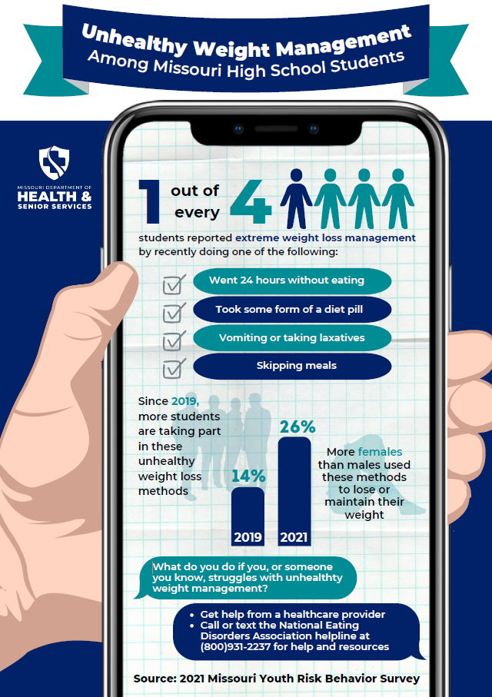

Slide 36
Sexual Activity

Slide 37
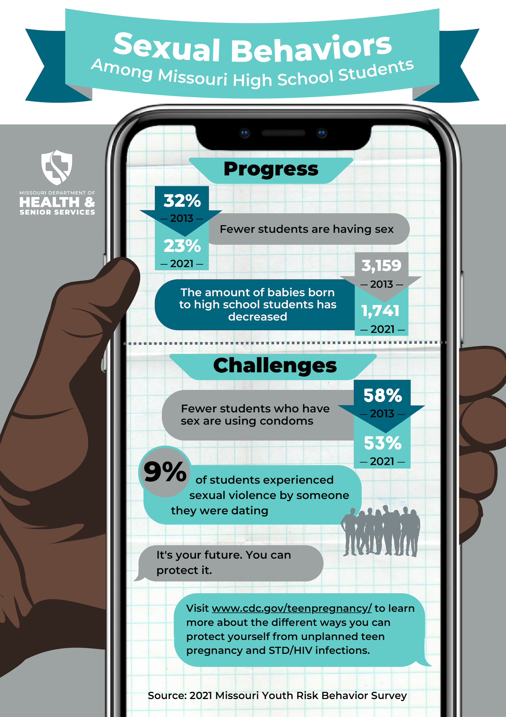

Slide 38
Summary
Monitor
Inform
Process
Data Dissemination
Notes:
The YRBS is a biennial school-based survey to gather data on student demographics, health behaviors, substance use, and student experiences
It is used to monitor health behaviors over time, help guide program review, needs, funding and monitor progress towards state and federal objectives
The survey administration involves random school selection, class selection, administering the survey, CDC data analysis, and finally data dissemination by way of infographics, dashboards, or presentations
Data is available online at https://health.mo.gov/data/yrbss/index.php and you can also find detailed reports, infographics (I have a few copies), the previous year’s questionnaires, FAQs, and more.

Slide 39
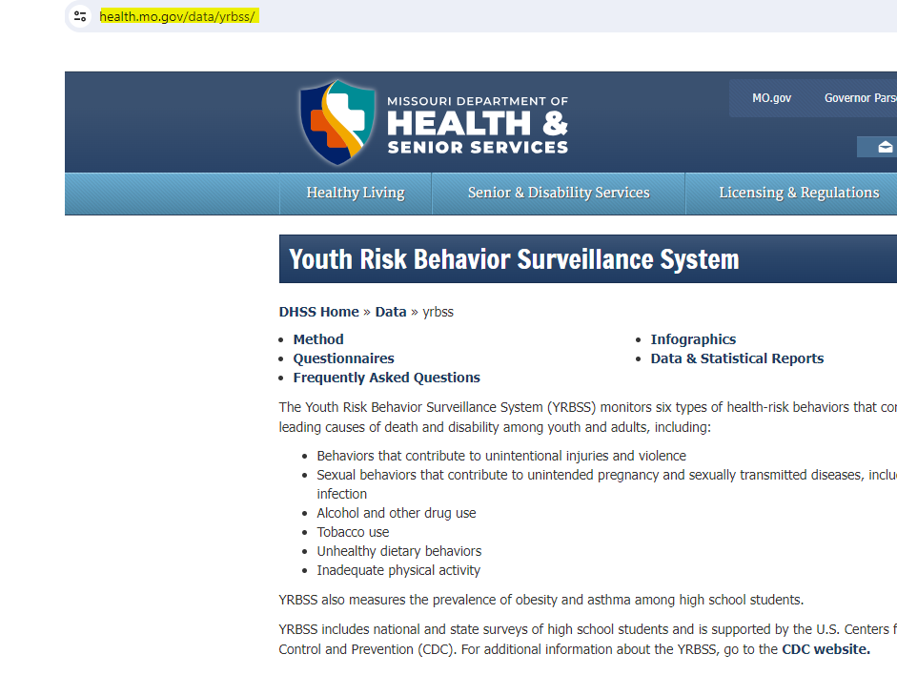
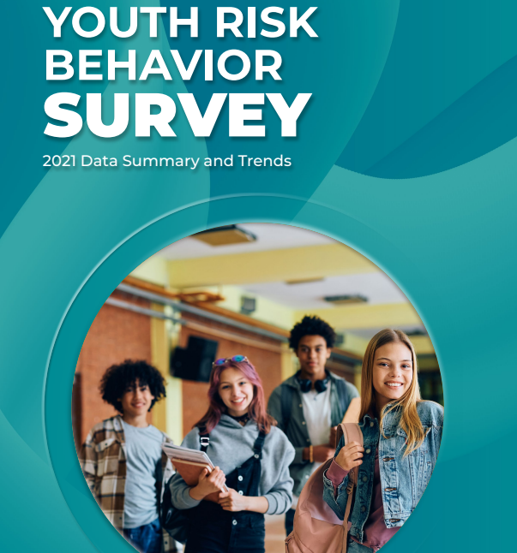

Slide 40
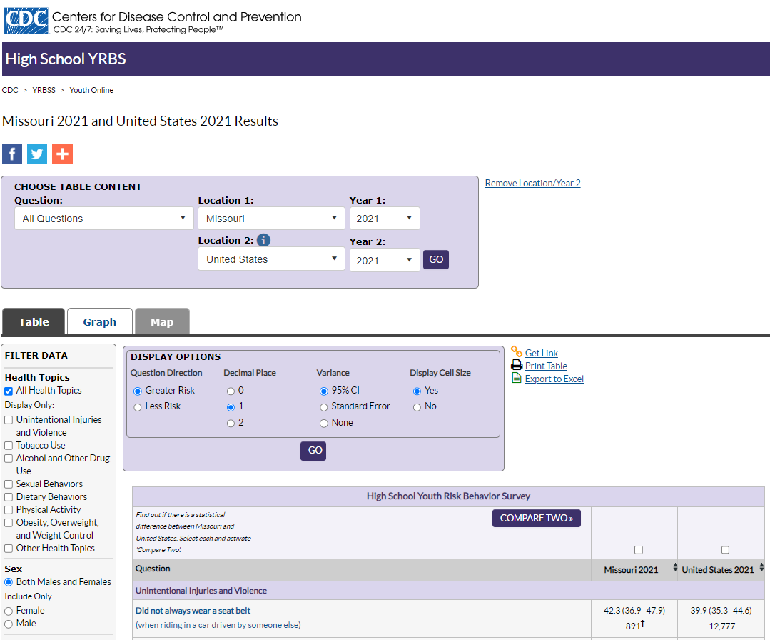
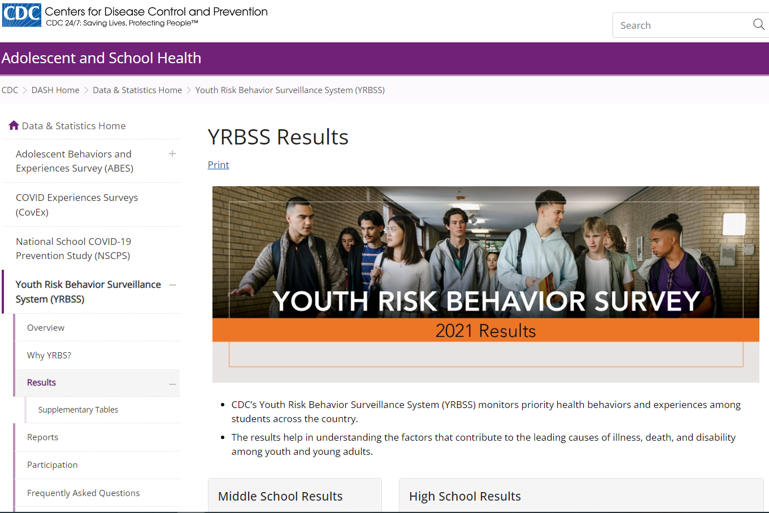

Slide 41



Missouri Department of Health and Senior Services: Youth Risk Behavior Surveillance System (YRBSS)
https://health.mo.gov/data/yrbss/
Missouri Department of Elementary and Secondary Education
https://dese.mo.gov/
QUESTIONS?
Shaquille Christmas:
Shaquille.Christmas@health.mo.gov
573-526-4021
Lisa Giles:
Lisa.Giles@health.mo.gov
Anthony Belenchia:
Anthony.Belenchia@health.mo.gov

