Slide 1
Health.Mo.Gov

Slide 2
6+++++
Partnering with your Local Public Health Agency to Improve
Maternal Child Health Outcomes
February 23, 2024
Sara Gorman, MCH Services Program Manager, Missouri Department of Health and Senior Services
Monica Mueller, Community Health Specialist, Stone County Health Department
Katie Vannoy, BSN, RN, Shelby County Health Department

Slide 3
Discussion Topics
Missouri Department of Health and Senior Services
Local Public Health Agency Partners
Maternal Child Health (MCH) Services Program
Missouri Revised Statutes Related to Health and Safety
Power of Partnership
Partner Sharing

Slide 4
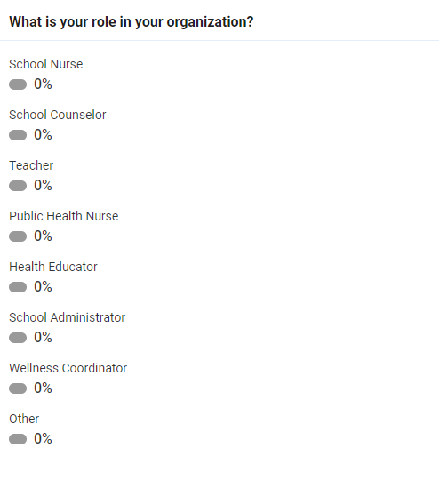

Slide 5
History of Missouri Department of Health and Senior Services
MO DHSS
1883
1967
1985
2001
March 29, 1883, Missouri Legislature created a State Board of Health
October 1967, Legislature State Board of Health within Division of Health; Governor appointed the members.
July 29, 1985, Department of Health was created and empowered to manage all public health functions.
August 28, 2001, becomes Department of Health and Senior Services. Focusing on prevention and quality of life for ALL Missourians.
Notes:
In 1883 the citizens of Missouri realized that the state could not prosper if the health of its residents was not protected. Epidemics of smallpox, typhoid and cholera severely threatened the health and welfare of Missourians. Concerned physicians led a citizens’ campaign to establish a state agency responsible for the promotion of the people’s health and the prevention of disease. On March 29, 1883, the Missouri Legislature responded by creating a State Board of Health. The steady increase in the population and the extended life expectancy of Missourians show that the first State Board of Health successfully fulfilled its mandate to build an effective state public health agency. When state government was reorganized in 1945, the Board of Health was superseded by the Division of Health of the Department of Public Health and Welfare.
In October, 1967 the Legislature again created a State Board of Health but within the framework of the Division of Health. Members of the Board of Health are appointed by the Governor with the advice and consent of the Senate. State government reorganization in 1974 placed the Division of Health in the Department of Social Services. At that time, the division’s environmental engineering and solid waste programs were transferred to the Department of Natural Resources and the Missouri Crippled Children’s Service became a part of the Division of Health.
After the 83rd General Assembly passed Senate Bill 25 and Governor John Ashcroft signed the legislation on July 29, 1985, the Department of Health (DOH) was created. That September, the department was officially empowered, charged with supervising and managing all public health functions and programs formerly administered by the Division of Health.
Executive Order 01-02, signed on Jan. 5, 2001, by Governor Roger Wilson, transferred the Division of Aging to the Department of Health effective Aug. 28, 2001, to become the Department of Health and Senior Services. Combining senior and public health issues into one system has allowed the department to more effectively focus on prevention and quality of life for all Missourians.

Slide 6
History of Local Public Health in Missouri
From the beginning….
1932
6 counties in Missouri had a health agency
ALL 6 of them were administered by county courts
1948
The number of health agencies increased to 21
State law changed to allow county public health agencies to be supported by a tax levy and governed by a board of Trustees
1973
The number of health agencies increased to 77
The state legislature appropriated approximately $2.5 million in federal funds to help counties establish public health agencies
1991
The number of health agencies increased to 81
The majority of the public health agencies governed by county commissions were located in the central part of the state.
2024
Missouri has 115 local public health agencies
All have various forms of governance
Most (89) of the agencies are funded by a dedicated tax
County commissions govern 18 of the agencies
8 have other forms of governance, including city charter, city/county agreement, or other unique agreement
Notes:
Local public health agencies located throughout Missouri work to improve the health of thousands of Missourians every year. These agencies address a wide range of public health issues, from assessing the health risks of environmental problems to providing emergency services during natural disasters. Local public health agencies protect food safety by inspecting restaurants and grocery stores. And they work to control communicable diseases such as flu and tuberculosis and to alleviate chronic conditions, including heart disease, diabetes, and stroke.
Most local public health agencies were formed under Chapter 205, Revised Statutes of Missouri, which allows counties to enact a property tax to support local public health services. Each of these public health agencies has an elected board of trustees that sets policy for the agency.
Other local public health agencies are governed by locally elected bodies such as county commissions and city and county councils. Local funding for those agencies comes from city and county general revenue.
Missouri’s 115 local public health agencies operate independently of each other and are independent of state and federal public health agencies. The local agencies work directly with the Missouri Department of Health and Senior Services through contracts to deliver public health services to the communities they serve. Funding for many of the contracts comes from the Centers for Disease Control and Prevention, other federal agencies, state general revenue and other sources. The state health department also provides technical support, laboratory services, a communication network and other services to support local public health efforts.
Local public health agencies also work with numerous partners, including private health care professionals and health advocacy organizations, to improve the health of Missourians.
One of the MCH Services Contract deliverables in selecting a priority issue and developing a contract work plan is:
-based on an examination of state and local quantitative and qualitative data, community engagement, and self-determination of local capacity, the Contractor shall complete a focused local assessment of the health status, strengths, weaknesses, and needs of the MCH population in their community, based on the population domains of women/maternal, perinatal/infant, child, and adolescent, and existing health inequities and weaknesses/gaps in access to care.
-the Contractor shall seek input from MCH stakeholders including families/consumers, providers and other community partners about the issues related to local MCH program services and delivery.

Slide 7
Revenue
Sources
Local taxes
Grants
Contracts
Fees and donations
State funds through contractual arrangements
Federal funds -direct or through MO DHSS
Notes:
LPHAs in Missouri are funded by local taxes, grants, contracts, fees and donations, state funds through contractual arrangements, and federal funds- direct or through Missouri Department of Health and Senior Services. For today’s purposes, specific to the MCH Services contract, we will be referring to the use of federal funds.

Slide 8
Missouri Department of Health and Senior Services
and the Title V MCH Block Grant
As the State’s Designated Health Agency, DHSS administers the Title V MCH Block Grant
Provides funding for both state-
and local- level MCH work
Plays a key role in the provision of maternal and child health services in Missouri
Funds are distributed among programs that target the improvement of the health of women and infants, children and adolescents, and children with special health care needs
Notes:
Missouri receives funding from the MCH Bureau of the U.S. Health Resources and Services Administration for improving the health of women (particularly mothers) and children. This funding is known as the Title V Maternal and Child Health (MCH) Block Grant and provides funding for both state- and local-level MCH work. The Missouri Department of Health and Senior Services, Division of Community and Public Health is responsible for administering the MCH Block Grant for the State of Missouri.
The Title V MCH Block Grant plays a key role in the provision of maternal and child health services in Missouri. Funds from this grant are distributed among a number of programs which target the improvement of the health of women and infants, children and adolescents, and children with special health care needs.
Every five years, a statewide needs assessment is conducted to identify state maternal and child health priority needs and direct Title V resources to meet these MCH challenges/needs through state/local partnerships and collaboration. The five-year needs assessment process in Missouri led to the identification of five national and three state priority areas and two overarching themes to be applied across all priorities, performance measures, and strategies.
National Priority Areas
Improve pre-conception, prenatal and postpartum health care services for women of child-bearing age
Promote safe sleep practices among newborns to reduce sleep-related infant deaths
Reduce intentional and unintentional injuries among children and adolescents
Reduce obesity among children and adolescents
Ensure coordinated, comprehensive and ongoing health care services for children with and without special health care needs
State Priority Areas
Enhance access to oral health care services for children
Promote Protective Factors for Youth and Families to Prevent and Reduce Youth Suicide & Self-Harm
Address Social Determinants of Health Inequities through Training & Health Literacy (Cross-cutting)
Overarching Principles
Ensure Access to Care, including adequate insurance coverage, for MCH population
Promote partnerships with individuals, families, and family-led organizations to ensure family engagement in decision-making, program planning, service delivery, and quality improvement activities

Slide 9
MCH Services Contract
Purpose
State and Local partnership to support a leadership role for LPHAs at the local level
Build community-based systems and expand the resources those systems can use to respond to priority maternal child health issues
Provide and assure mothers and children access to quality MCH services; reduce health disparities for women, infants, and children, including those with special health care needs
Promote the health of mothers and infants by assuring prenatal, delivery, and postpartum care for low income, at-risk pregnant women AND promote the health of children by providing preventive and primary care services for low- income children
Notes:
The MCH Services Program is 100% funded by Title V MCH Block Grant funding. Any local public health agency in Missouri is eligible to participate in the Maternal Child Health (MCH) Services Contract after completion and approval of a proposal referred to as the contract work plan and completion and approval of an annual contract budget.
The purpose of the MCH Services contract is to support a leadership role for LPHAs at the local level to: build community-based systems and expand the resources those systems can use to respond to priority maternal child health issues; provide and assure mothers and children (in particular those with low income or with limited availability of health services) access to quality MCH services; reduce health disparities for women, infants, and children, including those with special health care needs; promote the health of mothers and infants by assuring prenatal, delivery, and postpartum care for low income, at-risk pregnant women; and promote the health of children by providing preventive and primary care services for low income children. The Contractor’s efforts to fulfill the purpose of the MCH Services contract will include activities and services that address the needs of children and youth with special health care needs (CYSHCN).

Slide 10
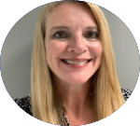
MCH Services Program
Meet the Team
Sara Gorman
Program Manager
Amy Bradshaw
East/Southeast DNC
Lindsey Cobb
Southwest DNC
Macey Shinn
West Central DNC
Sara Thompson
Northern DNC

Slide 11
FFY2020-2025
Priority Health Issues
Improve pre-conception, prenatal and postpartum
health care services for women of childbearing age
Promote safe sleep among newborns to reduce
sleep-related infant deaths
20
7
Reduce obesity among children and adolescents
Enhance access to oral health care services
for children
23
7
Reduce intentional and unintentional injuries among children and adolescents
Ensure coordinated, comprehensive and ongoing health care services for children with and without special health care needs
23
1
Promote protective factors for
youth and families
Address social determinants of health inequities
32
1
Notes:
LPHAs have developed five-year work plans to address these priority health issues-
20 have selected improving pre-conception, prenatal and postpartum health care services for women of childbearing age
23 have selected reducing obesity among children and adolescents
23 have selected reducing intentional and unintentional injuries among children and adolescents
32 have selected promote protective factors for youth and families
7 have selected promoting safe-sleep among newborns to reduce sleep-related infant deaths
7 have selected enhancing access to oral health care services for children
1 has selected ensuring coordinated, comprehensive, and ongoing health care service for children with and without special health care needs
1 has selected addressing social determinants of health inequities

Slide 12
Missouri Revised Statutes
(RSMo)
Section 170.310, RSMo
Section 170.307, RSMo
Section 170.045, RSMo
Section 167.720, RSMo
Upon graduation from high school, students in public and charter schools shall have received thirty minutes of CPR instruction and training in the Heimlich maneuver or other first aid for choking.
Upon graduation from high school, students in public and charter schools shall have received mental health awareness training. Instruction shall be included in the district’s existing health or physical education curriculum.
Each school district shall provide trauma-informed, developmentally appropriate sexual abuse training to students in all grades not lower than sixth grade, each school year.
School districts shall ensure that students in elementary school participate in moderate physical activity for an average of 150 minutes/5-day school week; a minimum of one recess period of twenty minutes/day shall be provided.
Notes:
Missouri Revised Statutes are passed by the Missouri General Assembly, which consists of the Missouri House of Representatives and the Missouri Senate.
These are four of the Missouri Revised Statutes that pertain to health and safety requirements for schools.
Your local public health agency often has the knowledge, skills and expertise to assist in obtaining completion of these requirements each school year. As these are required, someone on staff is responsible for adding these to his/her learning standards/curriculum requirements for the year.

Slide 13
Power of
Partnership
Help develop policy for health promotion
Provide professional development and training opportunities for school personnel
Provide expertise and resources
Help “lighten the load” and meet goals of improving health
Developing joint plans and activities in response to children’s health needs
Notes:
References: https://www.aap.org/en/patient-care/school-health/teams-enhancing-school-health-services/teams-recommended-team-members/public-healthhealth-department-teams-partner/
https://chronicdisease.org/resource/resmgr/school_health/nacdd_health_department_and_.pdf

Slide 14
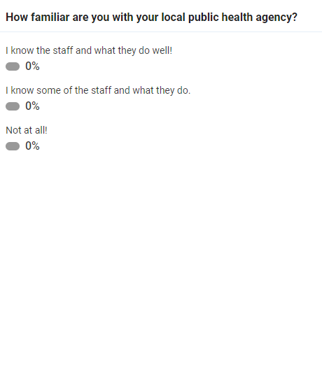

Slide 15
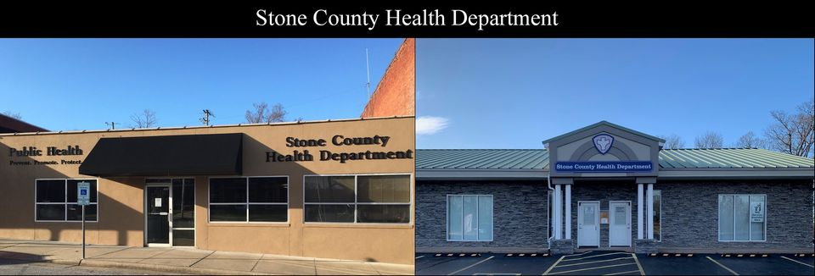
Stone County Health Department +
Galena R-II School District Partnership
Notes:
Stone County Health Department and Galena R-II School District to present here to Shelby County slides.

Slide 16
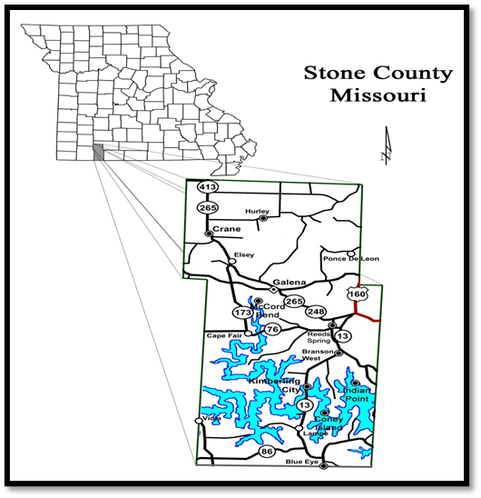
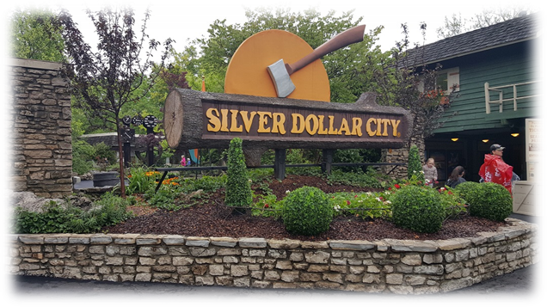
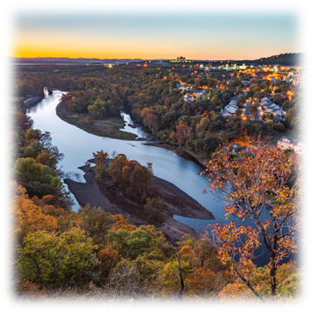
Stone County
Who We Are
1
3
Located in
Southwest Missouri
Largest Employer is
Silver Dollar City
2
4
Table Rock Lake is the biggest draw to the area
510.9 Square Miles, 463.2 land, 47.7 surface water

Slide 17
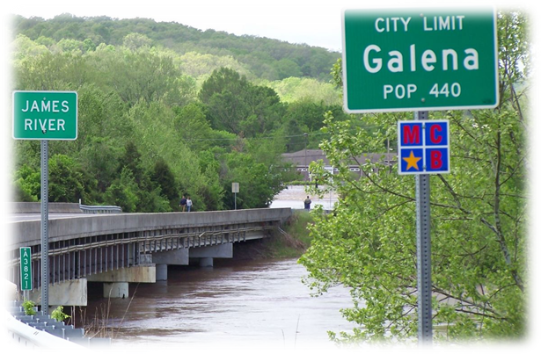
Galena R-II School District
Who We Are
1
3
Located in the heart of Stone County
More than 60% of students qualify for free or reduced school lunches
2
Approximately 500 students attend two schools; Galena-Abesville Elementary and Galena High School
4
4-day school weeks due to staffing shortages

Slide 18
Maternal Child Health (MCH) Services Contract
Priority Health Issues
After analyzing the data presented from the Community Health Assessment, the Community Health Coalition identified four health priorities. These priorities were deemed to be high priority/ low status, meaning that they were major concerns in the community.
The health priorities were also considered to be strategic issues: fundamental policy changes or critical health challenges that must be addressed for a community to achieve its vision.
Behavioral Health (Substance Use and Misuse)
1
3
Chronic Disease (Heart Disease)
2
Mental Health and Wellness (Suicide)
4
Social Health (Poverty)

Slide 19
How the
Partnership
Developed….
Contacted School
Was told not now for at least five years
Began Working with Preschool Teacher
Was open to an opportunity that presented itself and knew that may lead to more
Continued to Work with Preschool Teacher
Developed good rapport
Trust with Time
Continued to work with high school teacher and built a trusting partnership with principal and school counselor as well
High School Teacher Developed a Biology of Public Health Course
High School teacher knew of partnership with preschool teacher and requested help with course

Slide 20
Achievements
as a Result of Partnership
Worked with Galena R-II school counselor to provide QPR Suicide Prevention Training to all 7th-12th graders at Galena R-II Middle and High School
Worked with Galena R-II School Counselor to provide QPR Suicide Prevention Training to all 7th-12th graders at Galena R-II Middle and High School, reaching over 300 students, staff, and teachers
Worked with Galena R-II to develop a policy that student name badges have the 988 message and other mental health resources printed on them. Approximately 500 students are in the district
Worked with Galena R-II and hosted an all-student assembly at the high school titled “The Dangers of Today’s Marijuana” by Laura Stack, founder of Johnny’s Ambassadors
2022
2023
2023
2023

Slide 21
Tips
To Replicate Partnership as an LPHA
Tip
Tip
Tip
Tip
Be persistent
“NO” may mean not now, doesn’t mean not ever
Break the ice
If school calls and requests help, be willing to jump in
Be involved and present
Show up at school events and community events
Communicate
how you can help meet learning standards
Start small and watch partnership blossom

Slide 22
Tips
To Replicate Partnership as Local Education Agency
Tip
Tip
Tip
Reach out to your LPHA with questions
LPHA staff have vast knowledge regarding public health and can help you identify best practice and recommendations for health.
Invite your LPHA to participate in school-based events
Invite LPHAs to participate in school-based clinics, family nights, back-to-school fairs, etc.
Know your LPHA
Introduce yourself to Administrator/
health department staff via email, phone, in-person.

Slide 23
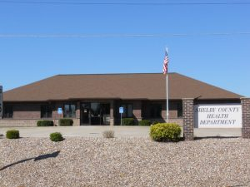
Shelby County Health Department +
North Shelby and South Shelby School Partnership
Notes:
Shelby County Health Department to present here to end.

Slide 24
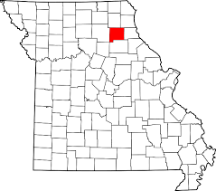
Shelby County
Who We Are
1
3
Located in the
Northeast part
of the state
County Seat: Shelbyville
2
4
County Population:
6,103
Known as hometown of Norm Stewart; legendary University of Missouri basketball coach

Slide 25
Shelby County School Districts
Who We Are
1
3
Two school districts, North Shelby and South Shelby.
PreK - 12th grade at both school districts.
2
298 students attend North Shelby and 706 attend South Shelby.

Slide 26
Maternal Child Health (MCH) Services Contract
Priority Health Issue
Reduce obesity among children and adolescents
1
Obesity in children is not just a Shelby County problem. Childhood Obesity is an epidemic! Over the past three decades, childhood obesity rates in America have TRIPLED and today nearly one in three children in America are overweight or obese.
.

Slide 27
How the
Partnership
Developed….
9 years ago, started working with school nurses, helping with yearly school screenings at each school
7 years ago, enrolled my child into Parents as Teachers Program – home visits and group activity nights monthly
Offered Health Department services at home visits and group activity nights
Have become a trusted partner; schools and
community partners reach out
Have been involved in the Wellness Communities at each district
Asked to join Parents as Teachers Advisory Board in 2020. Health Department is now a partner in the planning process

Slide 28
Achievements as a Result of Partnership
as a result of Partnership
Increased number of youth engaged in daily physical activity; created a county-wide youth cross country team with 30-38 youth runners each season which led to middle school developing a cross country team.
Increase in knowledge related to physical activity and nutrition education for children and families. Provided education at 6+ Parents as Teachers family nights and approximately 144 children participated.
Increased access to healthy food options in schools. Incorporated healthy food choices into sports concession menus at North Shelby.
Increase in community partners working together to improve health and wellness of children. Actively involved in both school districts’ Wellness Communities.
2021-Present
2023
2023
Present

Slide 29
Tips
To Replicate Partnership as an LPHA
Tip
Tip
Tip
Offer your time to volunteer for things like Wellness Committees, concession stands, and school screenings.
Call your schools and get to know them.
Get outside of the health department walls and get involved.

Slide 30
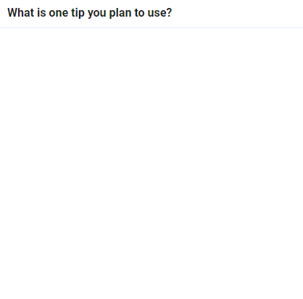

Slide 31
Monica Mueller
Monica.mueller@lpha.mo.gov
417-357-6134 ext. 2109
Rachel Oberdieck
QUESTIONS?
oberdieckr@galena.k12.mo.us
417-357-6618
Katie Vannoy
Katie.Vannoy@lpha.mo.gov
573-633-2352

Slide 32
Sara Gorman
Sara.gorman@health.mo.gov
573-522-2731
QUESTIONS?
This project is/was funded in part by the Missouri Department of Health and Senior Services Title V Maternal Child Health Services Block Grant and is/was supported by the Health Resources Services Administration (HRSA) of the U.S. Department of Health and Human Services (HHS) under grant #B04MC47428, Maternal and Child Health Services for $12,834,718, of which $0 is from non-governmental sources. This information or content and conclusions are those of the author and should not be construed as the official position or policy of, nor should any endorsements be inferred by HRSA, HHS or the U.S. Government.

Slide 33
PROTECTING HEALTH AND
KEEPING PEOPLE SAFE

